Slide 1
SC1015 Mini Project:
COVID-19 Predictor
Team Members:
Lee Ming Jia (U2121584A)
Andrada Angel John Bernardino (U21222963E)
Loo Qing Yan (U2122962C)
Lab Group SC13, Mini Group 3

Slide 2
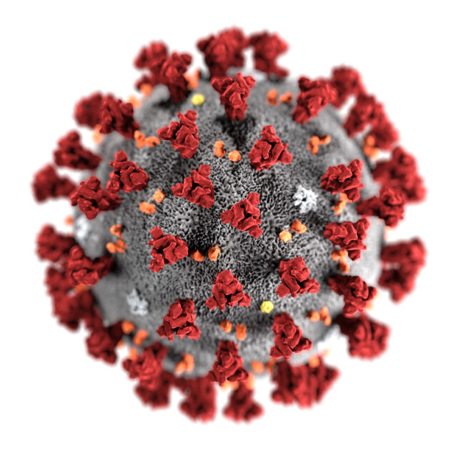

Background
COVID-19
Singapore Context
First Known case was discovered in China, Wuhan in December 2019
First case on 23/1/2020.
Since then, had over a million infection and approximately 1 thousand deaths

Slide 3
Problem Definition: Predicting the number of COVID-19 Cases using TWO different models and determined which model is better at predicting the number of COVID-19 Cases in Singapore.

Slide 4
Exploratory Data Analysis

Slide 5
Chosen variables to predict Covid 19 Cases
Daily Discharged
Intensive Care Unit (ICU)
Still Hospitalised
In Isolation MOH report

Slide 6
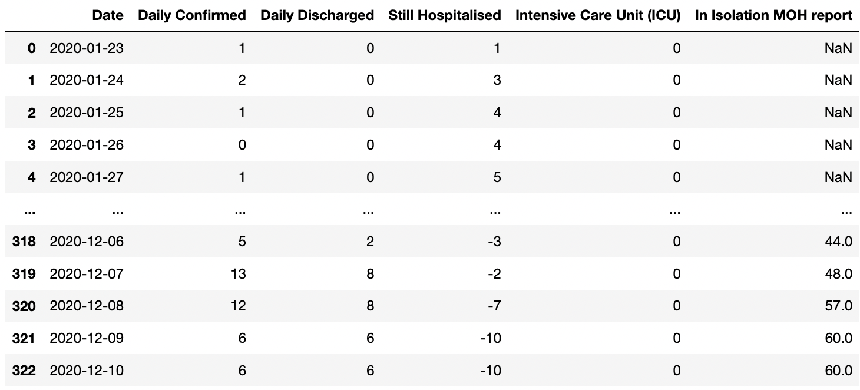
Cleaning Of Data
Presence of negative values for Still Hospitalised

Slide 7
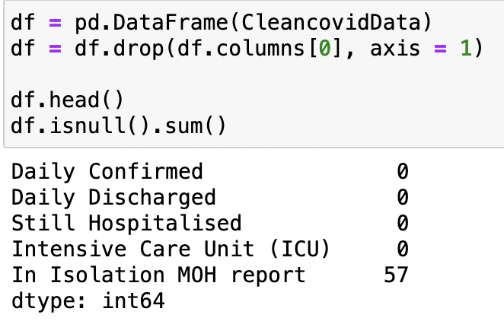
Cleaning Of Data
Presence of NULL values for In Isolation MOH report.

Slide 8
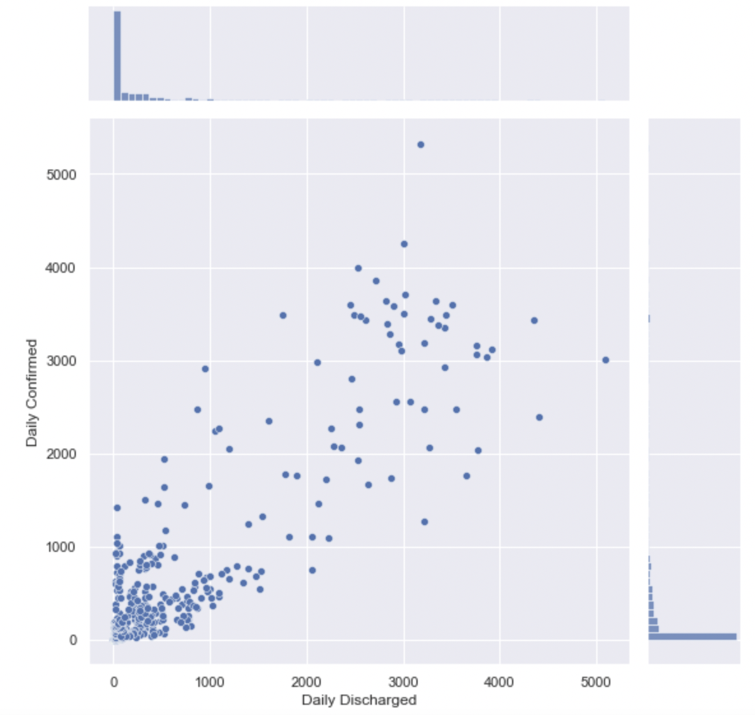
Daily Confirmed Against Daily Discharged:
Correlation of 0.892

Slide 9
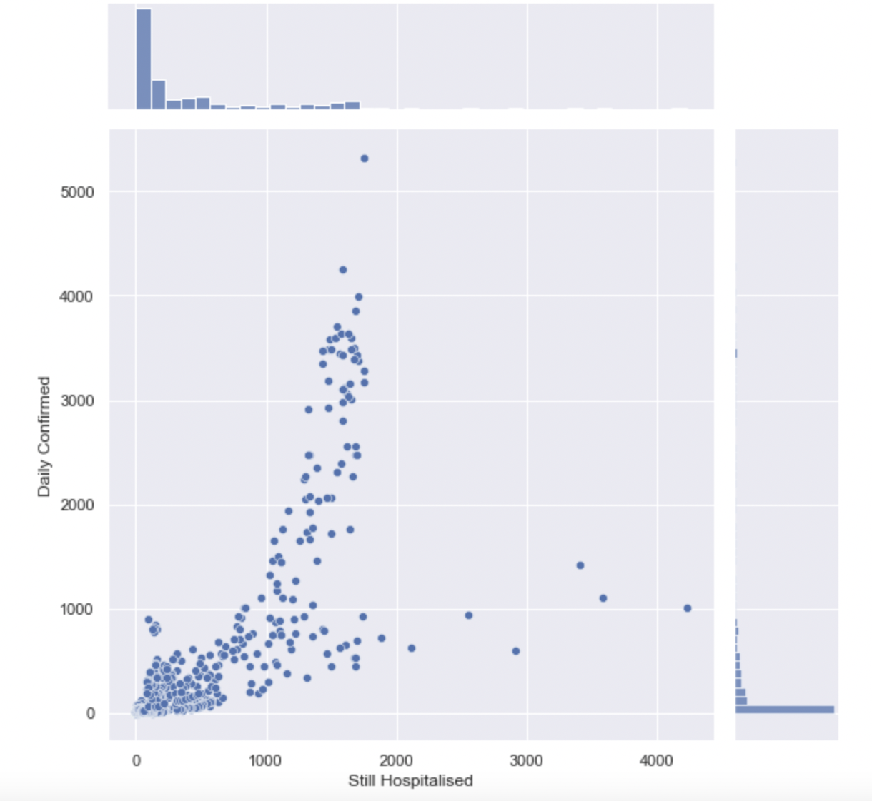
Daily Confirmed Against Still Hospitalised:
Correlation of 0.765

Slide 10
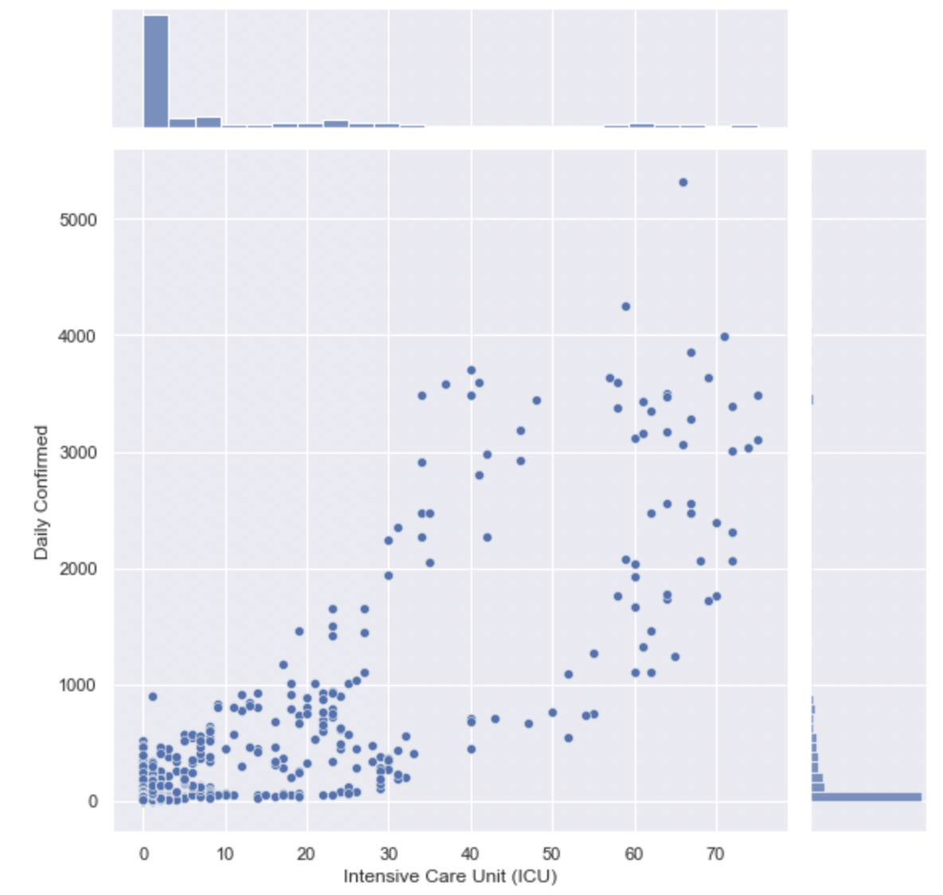
Daily Confirmed Against Intensive Care Unit (ICU):
Correlation of 0.847

Slide 11
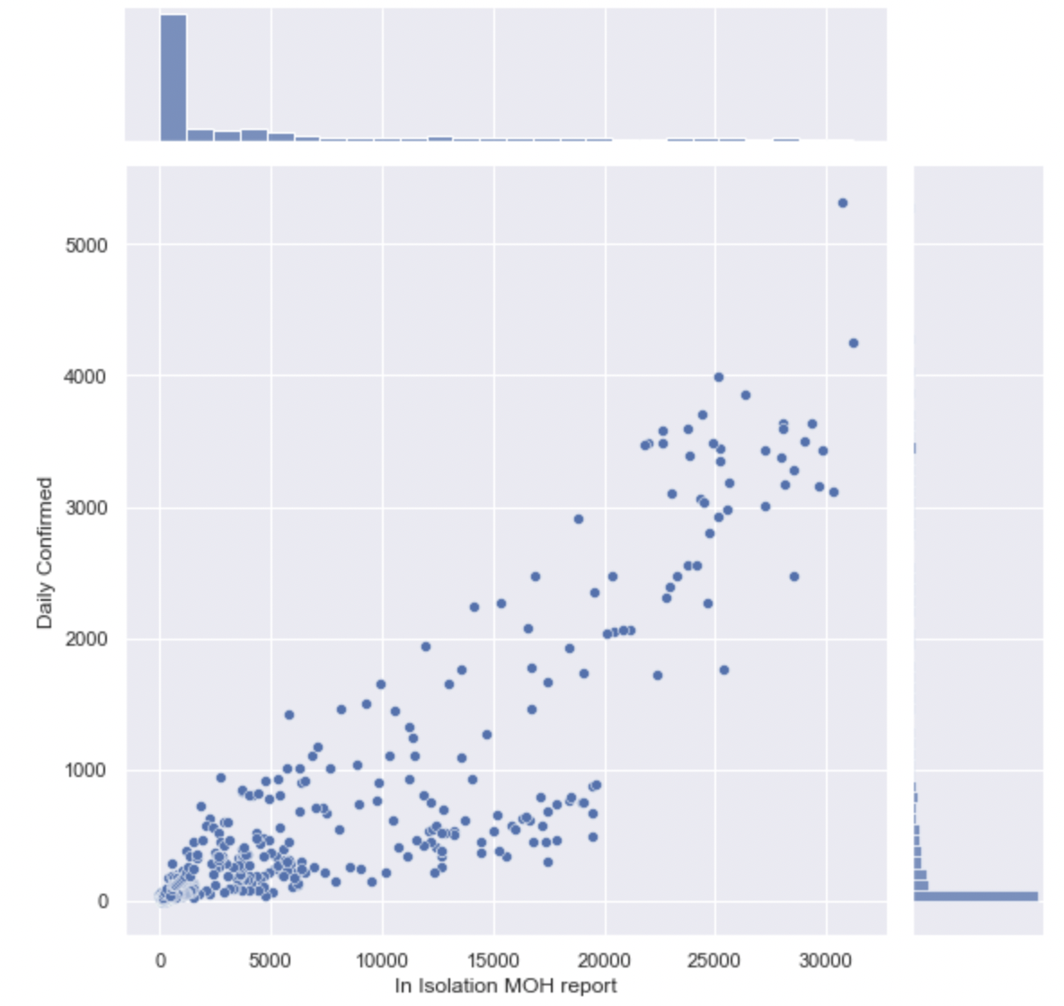
Daily Confirmed Against In Isolation MOH Report:
Correlation of 0.893

Slide 12
Machine Learning

Slide 13
Polynomial regression
Why
How
Able to take into account differences that is caused by different periods of time
Using the variable available to compare Daily Confirmed with the other factors.
Splitting of data into 80:20 for train and test

Slide 14
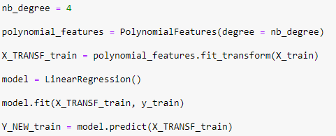
Polynomial regression
Using the above equation, we were able to assign the degree for the polynomial as well as do a model fitting for the dataset. This is repeated for the test and the other factors as well

Slide 15
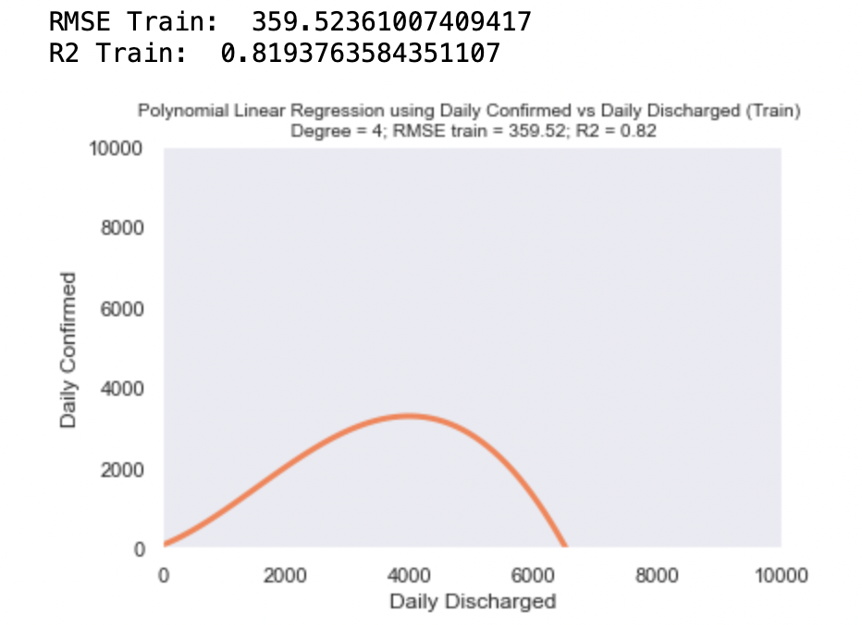
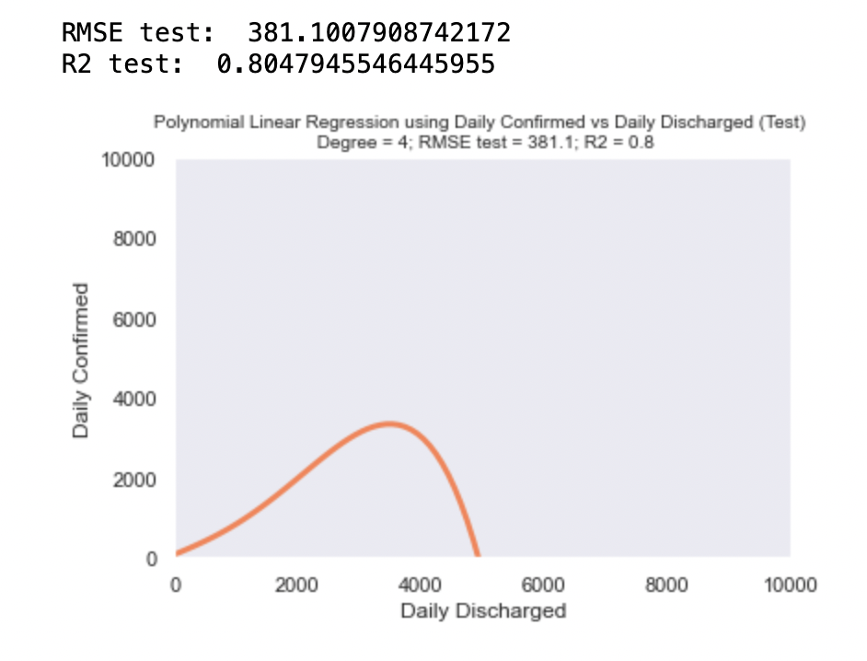
Polynomial regression

Slide 16
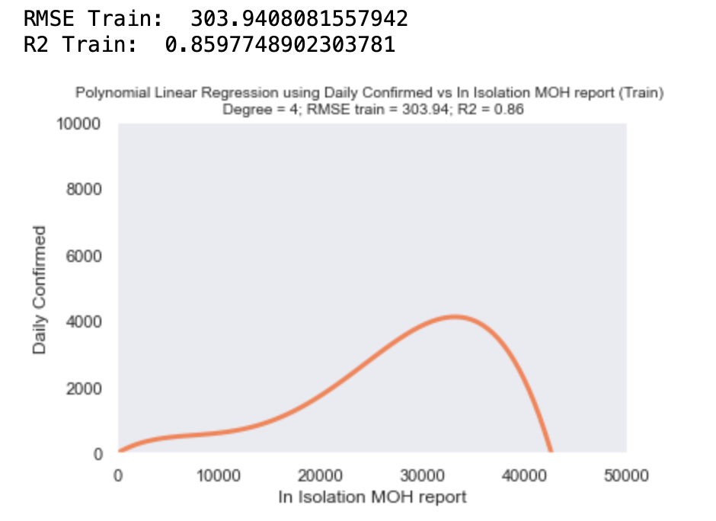
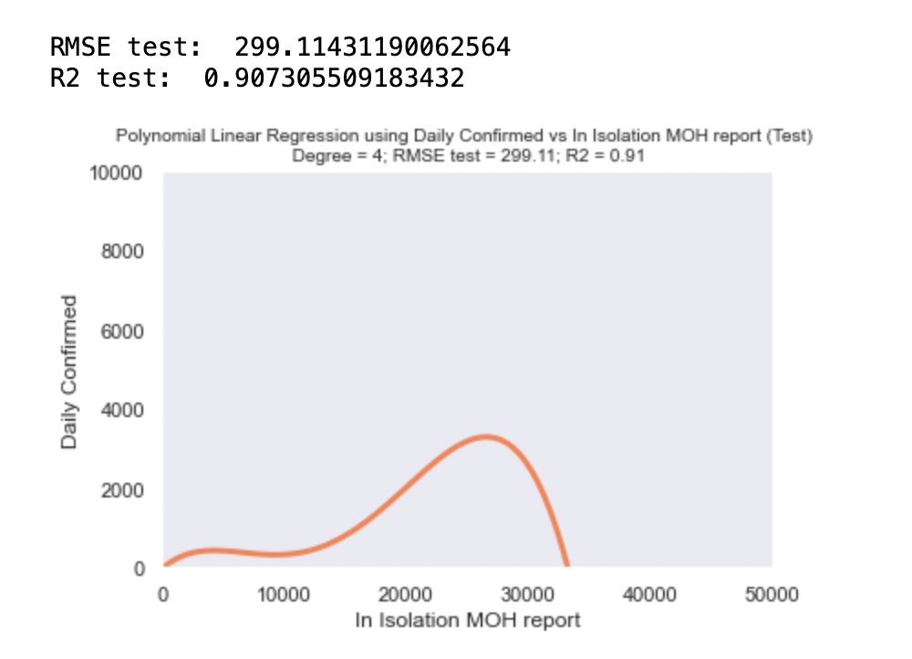
Polynomial regression

Slide 17
ARIMA Model (Auto-Regressive Integrated Moving Average)
Why
How
Effective machine learning algorithm for forecasting a time series
Using the variables from dataset to initialise the model with the help of readily available machine learning libraries

Slide 18
Training the ARIMA Model
Splitting of the dataset into 80:20 (Train:Test)
Using only “Daily Confirmed” variable

Slide 19
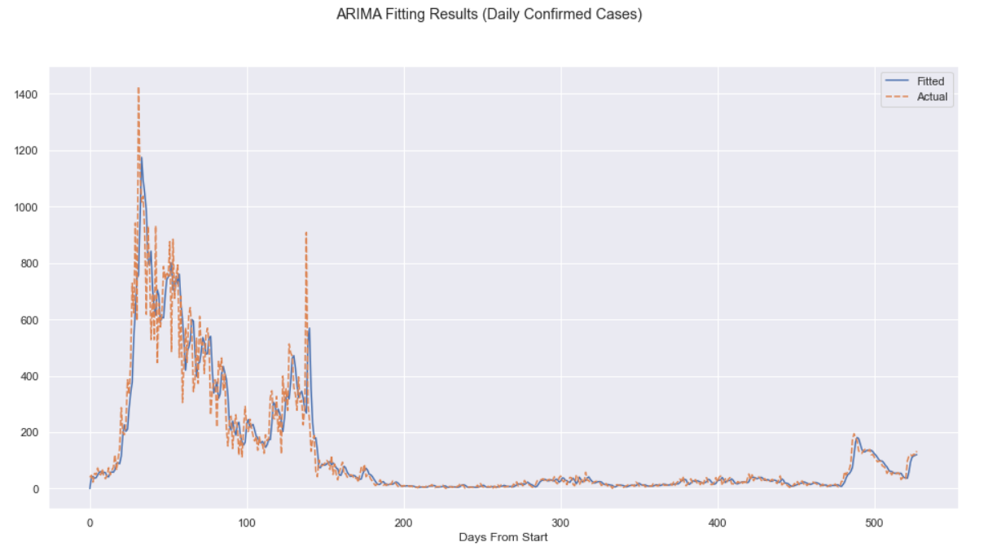
Training the ARIMA Model

Slide 20
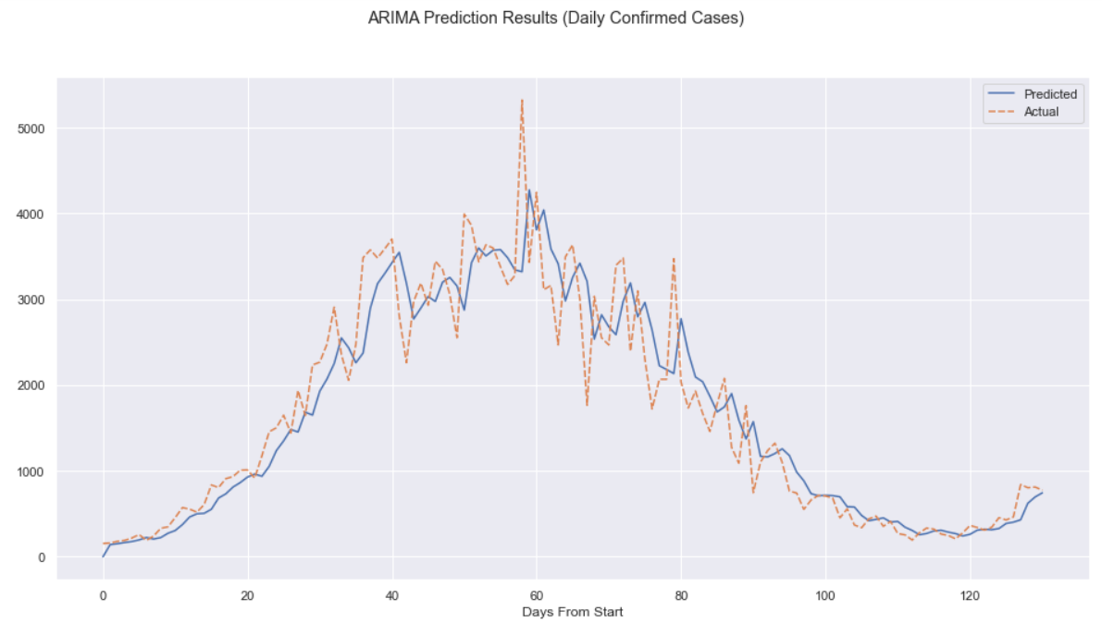
Predicting Test Data with ARIMA Model

Slide 21
What did we learn?
Outcome
Using different Machine Learning models
Polynomial Regression
Auto-Regressive Integrated Moving Average (ARIMA)
Comparing both Machine Learning models
Polynomial Regression is a better machine learning model
Prediction of daily confirmed covid cases is most accurate through Polynomial Regression

Slide 22

Thank You!

